Slide 1
COMPUTATIONAL ENGINEERING MECHANISM-2
21PHY113

Slide 2

BATCH-A,GROUP-15
P. KOMAL SAI ANURAG(CB.EN.U4AIE21039)
UDAYAGIRI VARUN (CB.EN.U4AIE21071)
SEJAL SINGH (CB.EN.U4AIE21061)
P.S.S.SAI.KEERTHANA(CB.EN.U4AIE21038)

Slide 3
INTRODUCTION
Complications of Traditional Electromechanical Robots
Robotic electromechanical drives require gearing systems to match the motor impedances to the appropriate loads.
These mechanisms can occasionally result in major issues that reduce the robots' ability to manage themselves.
For instance, harmonic motors, which are frequently utilised in current robots, have insufficient mechanical rigidity and substantial torque variability.
Backlash is the main issue with other robots' gear trains. Preloading gears is a frequent method for removing backlash. To maintain the least amount of backlash, these gears must be changed frequently.
Torque control cannot be accomplished with traditional electromechanical robots.

Slide 4
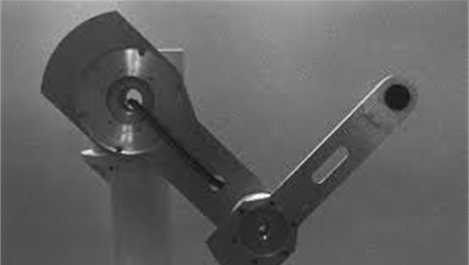
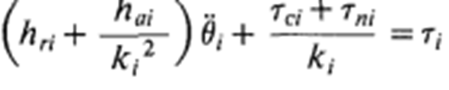
Direct Drive Arm
CONCEPT:
A direct-drive arm is a mechanical arm in which the shafts of articulated joints are directly coupled to the rotors of motors with high torque.
DRAWBACKS:
Robot would not be able to exert a large force for a long time without overheating the motors.
The weight of the motor itself is a load for the next motor down the serial linkage. Therefore, the drive torque required for each motor increases rapidly from the distal joint to the proximal joint.
The complicated arm dynamics are less significant when the actuator has a large gear ratio.​
The varying inertia, interactive and nonlinear forces are reflected directly to the motor axes and make the direct-drive most sensitive to the arm dynamics.​

Slide 5
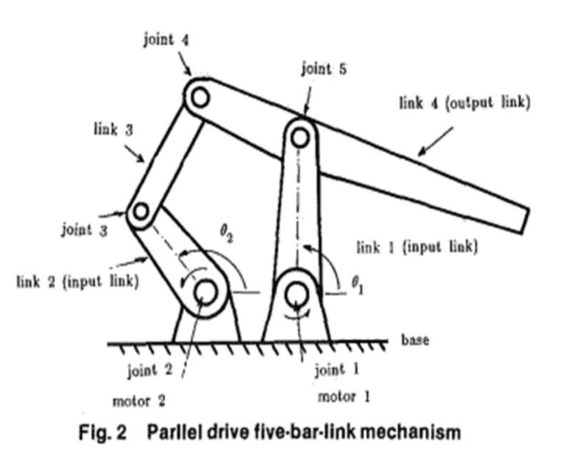
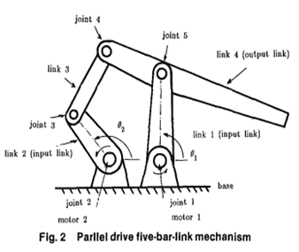
METHODOLOGY:
Two motors fixed on the base drive the two-input links and cause a 2-D motion at the tip of the arm.
The weight of one motor is not a load on the other.
Reaction torque of one motor does not act directly upon the other, because the motors are fixed on the base.
An arm mechanism in which motors are mounted on a fixture and the weight and reaction torque of one motor do not affect the other motors directly is referred to as a parallel drive mechanism.
The parallel drive mechanism has been used in several models of commercial robots that have conventional electromechanical drives with gearings.
The advantages of the parallel drive mechanism are:
Lightweight
lower interaction and nonlinearity
lower power dissipation.

Slide 6
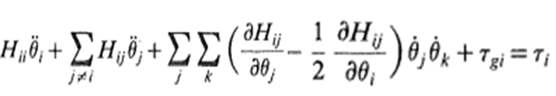
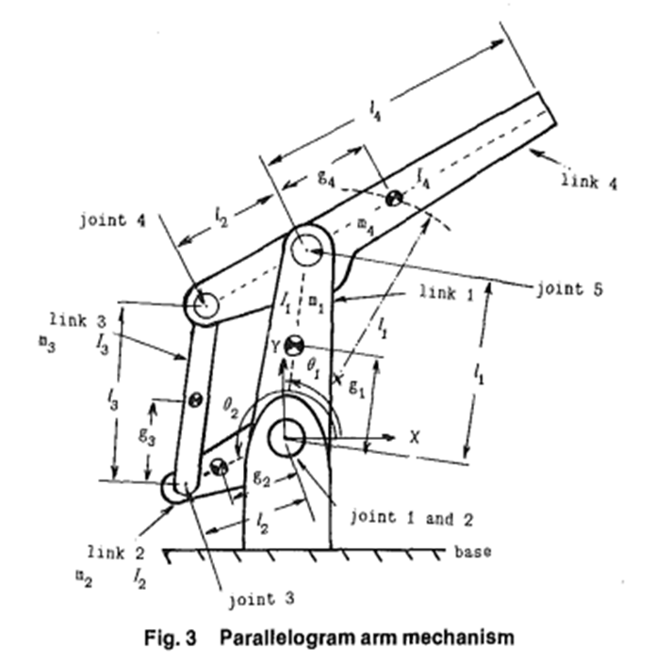
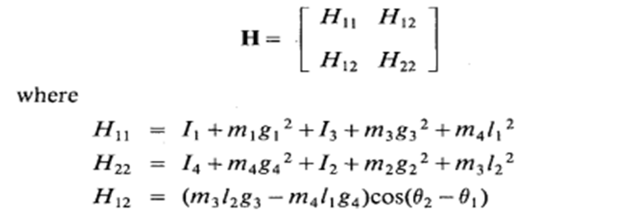
Invariant and Decoupled Arm Inertia
Let ϴi, and Ti be the angle and torque of the ith motor, then the equation of motion of a direct-drive arm is given by
We design an arm structure and its mass properties so that the arm has an invariant and decoupled inertia tensor which causes no nonlinear velocity torque. Namely, we derive the conditions that is mentioned below.
The arm dynamics is then ideally simple having only the first and the last terms of the above equation. ​
The inertia tensor of the arm mechanism ​is then given by:

Slide 7
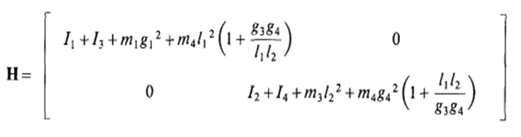
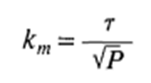
It is possible to eliminate the interaction completely for all configurations by modifying the mass ratio of link 3 and link 4, m₄/m₃ the ratio of mass center distances of the two links, g₄/g₃ and/or the length l₂ so that the coefficient (m₃l₂g₃ - m₄l₁g₄) becomes zero. The resultant inertia tensor that satisfies the above condition reduced to :
The inertia tensor is invariant and completely decoupled. Therefore, there are no variations in motor load, no interactions, no Coriolis and centrifugal forces.
Power Dissipation
The robot's inability to apply much force is another issue with direct drive. Motor output torques are not enhanced by reducers because motors are directly coupled to their loads. As a result, the motors must bear the loads directly and risk overheating, especially in stalling conditions.
An important specification of a torque motor is the motor constant, that is, the ratio of output torque r to the square root of power dissipated in the motor P

Slide 8
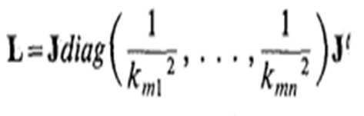
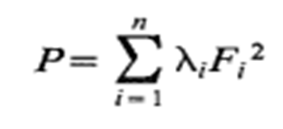
When a robot bears a load at the arm tip, the load is distributed to the multiple motors connected to the arm mechanism. Let F be the end point force exerted at the arm tip represented in cartesian coordinates, and let r be the vector of equivalent torques of n motors then one obtains $τ=J^{′} F$
The matrix L is positive definite as long as the Jacobian matrix is nonsingular. Therefore, the matrix L has all real, positive eigenvalues, λi > 0, and the quadratic form can be rewritten as
Where
F $→$is the component of end point force along the eigenvector corresponding to λi

Slide 9
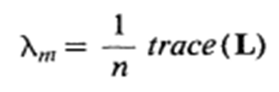
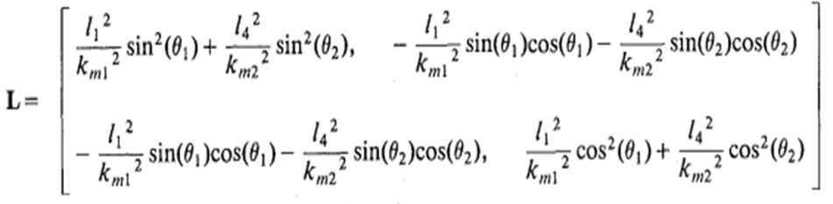
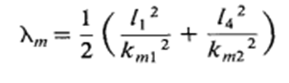
To evaluate the overall efficiency of the arm-motor combination, we define the mean power dissipation ratio, which is the mean of the eigenvalues and is given by λm.
For the five-bar-link parallel drive mechanism, matrix L is given by
The mean power dissipation ratio is then given by
Although matrix L varies depending on the arm configuration, the mean power dissipation λm is uniform for all the configurations.

Slide 10
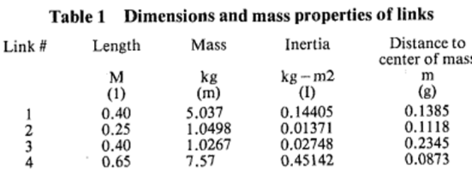
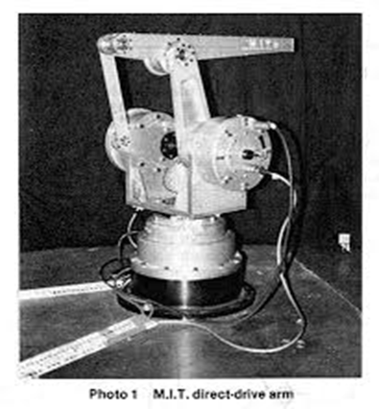
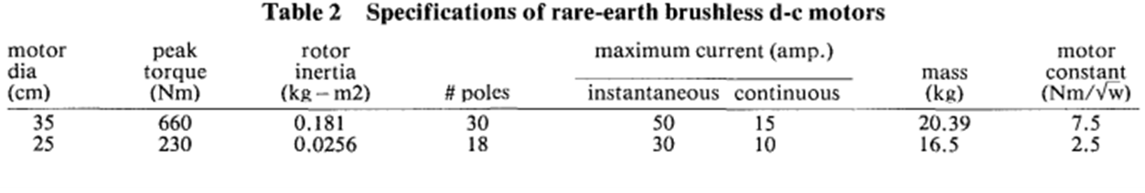
ANALYSIS
Development of a Prototype Arm
The arm structure is basically the five-bar-link parallel drive mechanism. Table below lists the dimensions and mass properties of the links that satisfy the condition for the decoupled inertia tensor.
In addition to the five-bar-link arm mechanism, the arm has another rotational joint at the base part to permit three- dimensional motions
When strong currents are applied to the windings, there is no spark that forms at the commutator.
The maximal magnetic energy of the permanent magnet, a new variety of samarium cobalt magnet, is 26 MGOe. An overview of the motor specs is shown in Table 2. The motor used to power the base joint has a 35 cm outside diameter and a peak torque of 660 Nm

Slide 11
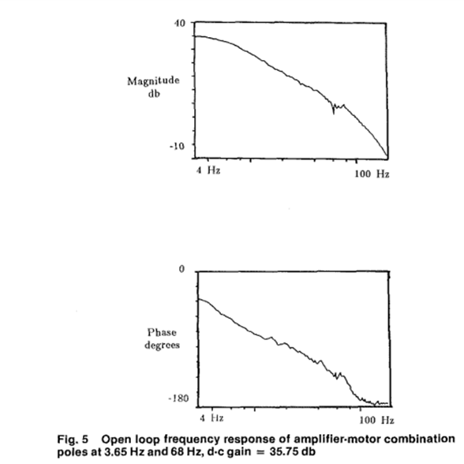
In comparison with the largest motor used for the direct-drive robot, which is a DC torquer with alnico magnet, the newly developed motor has over three times the peak torque and smaller than 60 percent in outer diameter. The motor constant is 7.5 Nm/√W.
The two motors used for driving the five-bar-link mechanism have a motor constant of 2.5 Nm/√W, and a peak torque of 230 Nm.
Control Performance:
The five-bar-link mechanism is driven by motor 1, and Figure 5 depicts the open-loop frequency characteristics of the motor.​
The motor's output is its angular velocity. ​
The frequency response has two poles, one of which is located about 3.65 Hz and the other at 68 Hz. ​

Slide 12
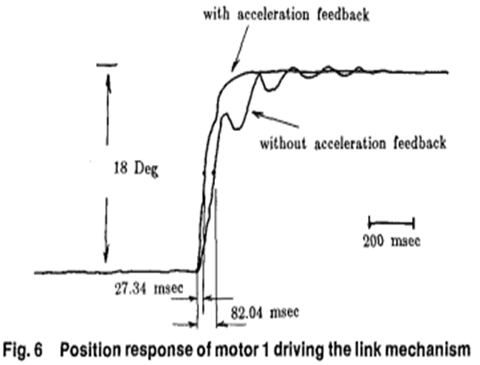
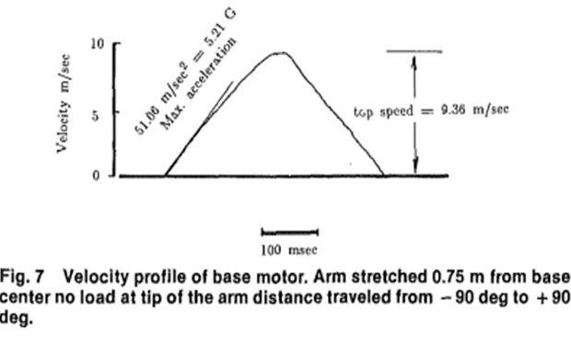
Figure 6 depicts Step response for motor 1 driving the five bar-link mechanism, when position and velocity were fed back.
The response, with a delay time of 82 ms, is fairly slow and poor in damping. When an acceleration feedback was included, the response was significantly improved . In this case the delay time is only 27 ms.
The stiffnesses achieved were 300 N/mm for the base joint and 416N/mm for the other two joints.
Figure 7 depicts the velocity curve as the base joint moved far from -90º to +90º
The speed shown corresponds to the final point. Rapid acceleration brought the end point up to peak speed. The slope's maximum acceleration is 52 m/s2, which is greater than 5G. 9.36 m/s was the highest speed recorded, which is also far faster than current robots.

Slide 13
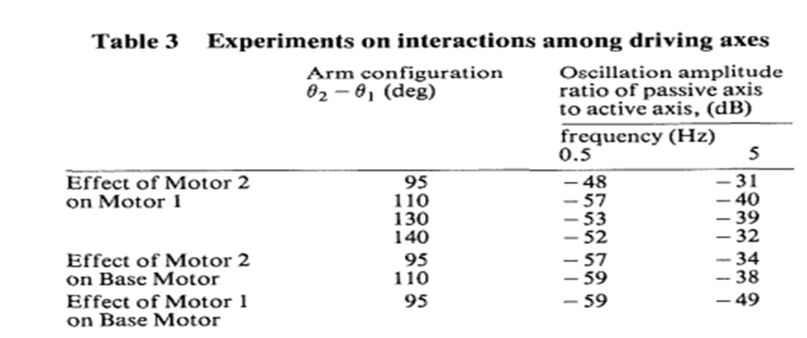
The coupling between the motors was tested in the experiment that follows. While the other motors are not serving, one motor drives the link mechanism by tracking a sinusoidal position command. A measurement of the coupling for the arm dynamics is the peak-to-peak ratios between the driving motor's actual position signals and those of the other motors.

Slide 14
CONCLUSION
For the direct-drive robots, a compact five-bar-link parallel drive mechanism was presented.
We can place motors at a base using the parallel drive mechanism so that the weight of one motor won't put additional strain on the other motors.
It was demonstrated that the parallel drive mechanism has a lower power dissipation than a serial drive that has the same motors and covers the same workspace by studying the internal power dissipation at the motors when applying a force at the tip of the arm.
The development of a prototype direct-drive robot with high torque brushless motors and a five-bar-link system with an invariant and decoupled arm inertia.
High servo stiffnesses, 300-400 N/mm at the arm tip, 27 ms delay time, approximately 10 m/s top speed, and 5 G acceleration were accomplished.
Compared to the serial drive, power dissipation was reduced by around 70%.
For all arm configurations, joint interactions were likewise decreased to less than - 30 dB.
As a result, the parallel drive mechanism and direct drive arm have achieved exceptional performance.

Slide 15

PHASE-B
02

Slide 16
QUESTION
Explore the Kinematic analysis of a Four-bar mechanism shown in the figure. Follow the vector approach to represent the closure equation.
Investigate on,
a) Solution to closure equation when link 2 is the driver
b) Solution to position when link 3 is the driver
c) Discuss the velocity and acceleration equations also. Demonstrate the numerical solution procedure in MATLAB using the Newton-Raphson method with a sample problem for all the cases discussed above.

Slide 17
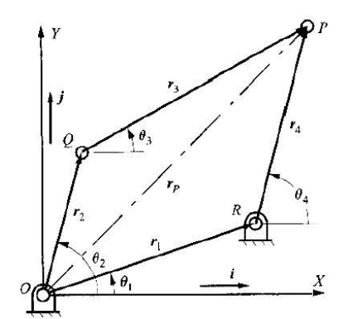
Loop closure equation for the given mechanism
The position of point P obtained by adding the vectors r2,r3 must be always same as that obtained by vectors r1,r4
Here, Link 1 is considered as base
So, r1 is a constant vector and corresponding angle θ1 is a constant angle.
VECTOR REPRESENTATION OF r1,r2.r3,r4
r₁ = l₁*cosθ1 Î + l₁*sinθ1 Ĵ
r₂ = l₂*cosθ2 Î + l₂*sinθ2 Ĵ
r₃ = l₃*cosθ3 Î + l₃*sinθ3 Ĵ
r₄ = l₄*cosθ4 Î + l₄*sinθ4 Ĵ
LOOP CLOSURE EQUATION
r_{p} = r1 + r4 = r2 + r3

Slide 18
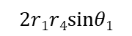
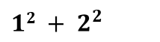
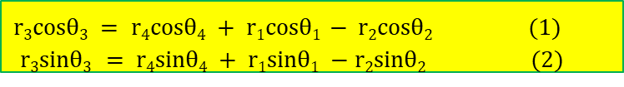
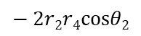
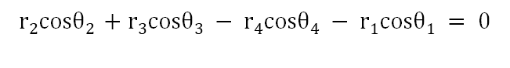
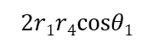
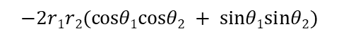

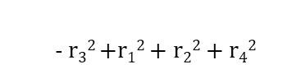

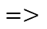
POSITION ANALYSIS
Applying the loop closure equation and separating the cos and sin terms we get two equations
$$r2cosθ2 +r3cosθ3 − r4cosθ4 − r1cosθ1 = 0$$
$r3cosθ3 = r4cosθ4 + r1cosθ1 − r2cosθ2$ (1)
$r3sinθ3 = r4sinθ4 + r1sinθ1 −r2sinθ2$(2)
$$r2sinθ2 + r3sinθ3 −r4sinθ4 − r1sinθ1 = 0$$
$$r32 ={r1}^{2} + r2^{2} + r4^{2} =$$
$12 + 2^{2}$
$$=>$$
2r₁r₄(cosθ₁cosθ₄ + sinθ₁sinθ₄)
-2r₁r₂(cosθ₁cosθ₂ + sinθ₁sinθ₂)
+2r₂r₄(cosθ₂cosθ₄ + sinθ₂sinθ₄)
Combining the coefficient of cosθ₄ and sin θ₄ yields
Acosθ₄ + Bsinθ₄ + C = 0
Where,
A =
$$2r1r4sinθ1$$
$$− 2r2r4cosθ2$$
B =
$$2r1r4cosθ1$$
$$− 2r2r4sinθ2$$
- r₃² +r₁² + r₂² + r₄²
C =
$$−2r1r2(cosθ1cosθ2 + sinθ1sinθ2)$$

Slide 19
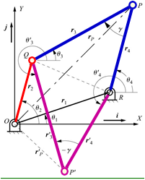
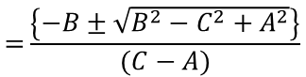
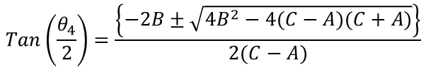
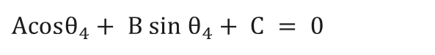
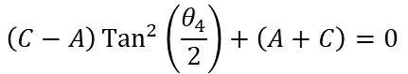
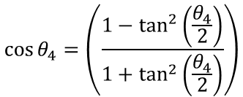
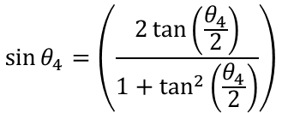
Position Analysis:
​$Acosθ_{4}+ B sin θ_{4}+ C = 0​$
$$\sin{θ_{4}}=\left(\frac{2\tan\left(\frac{θ_{4}}{2}\right)}{1+\tan^{2}\left(\frac{θ_{4}}{2}\right)}\right)$$
$$\cos{θ_{4}}=\left(\frac{1−\tan^{2}\left(\frac{θ_{4}}{2}\right)}{1+\tan^{2}\left(\frac{θ_{4}}{2}\right)}\right)$$
√
$$\left(C−A\right){Tan}^{2}\left(\frac{θ_{4}}{2}\right)+\left(A+C\right)=0$$
$$\operatorname{Tan}\left(\frac{θ_{4}}{2}\right)=\frac{\left\{−2B±\sqrt{4B^{2}−4(C−A)(C+A)}\right\}}{2(C−A)}$$
$$={\frac{\left\{−B±\sqrt{B^{2}−C^{2}+A^{2}}\right\}}{(C−A)}}$$
“±” corresponding to the two possible positions of the P for a given value of θ₂

Slide 20
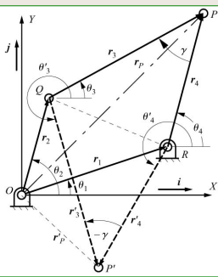
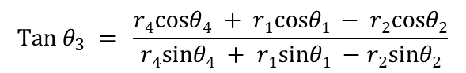
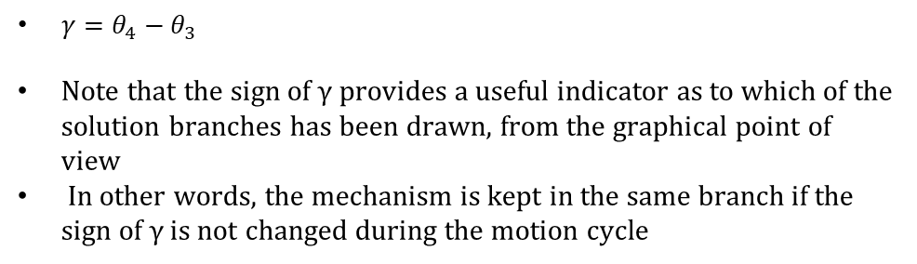
r₃cosθ₃ = r₄cosθ₄ + r₁cosθ₁ - r₂cosθ₂ (1)
r₃sinθ₃ = r₄sinθ₄ + r₁sinθ₁ -r₂sinθ₂ (2)
After θ₄ is known, dividing Eq. (2) be Eq. (1) and solving for θ₃ gives
$$\operatorname{Tan}{θ_{3}} = \frac{r4cosθ4 + r1cosθ1 − r2cosθ2}{r4sinθ4 + r1sinθ1 −r2sinθ2}$$
$γ=θ_{4}−θ_{3}$
Note that the sign of γ provides a useful indicator as to which of the solution branches has been drawn, from the graphical point of view
In other words, the mechanism is kept in the same branch if the sign of γ is not changed during the motion cycle

Slide 21
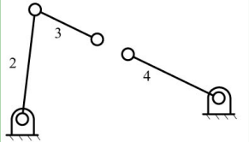
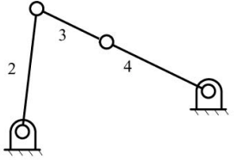
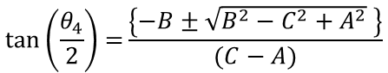
SPECIAL CASES
$$\tan\left(\frac{θ_{4}}{2}\right)={\frac{\left\{−B±\sqrt{B^{2}−C^{2}+A^{2}} \right\}}{(C−A)}}$$
No θ₄ can be found if B²-C²+A²<0
The mechanism cannot be assembled in the position specified
One θ₄ can be found if B²-C²+A²=0
link 2 is in one of its limit positions

Slide 22
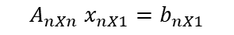

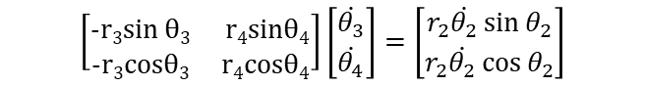
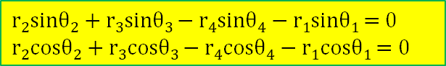
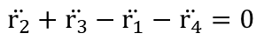
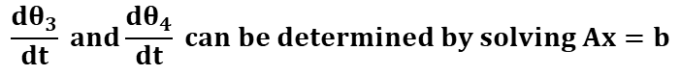
Velocity Analysis:
$$\text{r}\text{2}\text{sinθ}\text{2}\text{ + }\text{r}\text{3}\text{sinθ}\text{3 }\text{− }\text{r}\text{4}\text{sinθ}\text{4}\text{ − }\text{r}\text{1}\text{sinθ}\text{1 }\text{= 0 }$$
$$\text{r}\text{2}\text{cosθ}\text{2}\text{ + }\text{r}\text{3}\text{cosθ}\text{3 }\text{− }\text{r}\text{4}\text{cosθ}\text{4}\text{ − }\text{r}\text{1}\text{cosθ}\text{1 }\text{= 0 }$$
$$r_{2}+r_{3}−r_{1}−r_{4}=0$$
$${−r}_{2}\dot{θ_{2}}\sin{θ_{2}}−r_{3}\dot{θ_{3}}\sin{θ_{3}}{+r}_{4}\dot{θ_{4}}\sin{θ_{4}}+r_{1}\dot{θ_{1}}\sin{θ_{1}}=0$$
$$r_{2}\dot{θ_{2}}\cos{θ_{2}}+r_{3}\dot{θ_{3}}\cos{θ_{3}}{− r}_{4}\dot{θ_{4}}\cos{θ_{4}}−r_{1}\dot{θ_{1}}\cos{θ_{1}}=0$$
$$\ddot{r_{2}}+\ddot{r_{3}}−\ddot{r_{1}}−\ddot{r_{4}}=0$$
$${−r}_{3}\dot{θ_{3}}\sin{θ_{3}}+r_{4}\dot{θ_{4}}\sin{θ_{4}}{=r}_{2}\dot{θ_{2}}\sin{θ_{2}}$$
$${−r}_{3}\dot{θ_{3}}\cos{θ_{3}}+r_{4}\dot{θ_{4}}\cos{θ_{4}}{=r}_{2}\dot{θ_{2}}\cos{θ_{2}}$$
$$\frac{dθ_{3}}{dt} and\frac{dθ_{4}}{dt} can be determined by solving Ax=b$$
$$\left[\begin{matrix}\text{−}\text{r}\text{3}\text{sin} \text{θ}\text{3} & \text{r}\text{4}\text{sinθ}\text{4} \\ \text{−}\text{r}\text{3}\text{cosθ}\text{3} & \text{r}\text{4}\text{cosθ}\text{4}\end{matrix}\right]\left[\begin{matrix}\dot{θ_{3}} \\ \dot{θ_{4}}\end{matrix}\right]=\left[\begin{matrix}r_{2}\dot{θ_{2}}\sin{θ_{2}} \\ r_{2}\dot{θ_{2}}\cos{θ_{2}}\end{matrix}\right]$$
$$A_{nXn} x_{nX1}=b_{nX1}$$

Slide 23
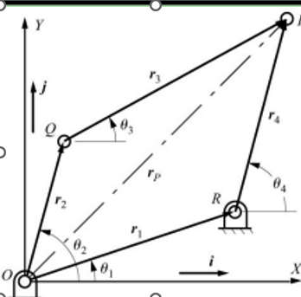










$$v_{p}= \dot{r_{p}}=\dot{r_{2}}+\dot{r_{3}}$$
$$=\frac{d}{dt}\left(r_{2}\cos{θ_{2}}i+r_{2}\sin{θ_{2}}j\right)+\frac{d}{dt}\left(r_{3}\cos{θ_{3}}+r_{3}\sin{θ_{3}}\right)$$
$$=\left(−r_{2}\dot{θ_{2}}\sin{θ_{2}}−r_{3}\dot{θ_{3}}\sin{θ_{3}}\right)i+\left(r_{2}\dot{θ_{2}}\cos{θ_{2}}+r_{3}\dot{θ_{3}}\cos{θ_{3}}\right)j$$
$$r_{p}=r_{2}+r_{3}=r_{1}+r_{4}$$
$$v_{p}= \dot{r_{p}}=\dot{r_{1}}+\dot{r_{4}}$$
$$=0+\frac{d}{dt}(r_{4}\cos{θ_{4}i+r_{4}\sin{θ_{4}j)}}$$
$$=\left(−r_{4}\dot{θ_{4}}\sin{θ_{4}}\right)i+(r_{4}\dot{θ_{4}}\cos{θ_{4})j}$$
$$r_{Q}=r_{2}$$
$$V_{Q}=\dot{r_{Q}}=\dot{r_{2}}$$
$$=\frac{d}{dt}(r_{2}\cos{θ_{2}i+r_{2}\sin{θ_{2}j)}}$$
$$V_{Q}=\left(−r_{2}\dot{θ_{2}}\sin{θ_{2}}\right)i+(r_{2}\dot{θ_{2}}\cos{θ_{2})j}$$

Slide 24





Acceleration Analysis:
$$\dot{r_{2}}+\dot{r_{3}}−\dot{r_{4}−}\dot{r_{1}}=0$$
$${−r}_{3}\dot{θ_{3}}\cos{θ_{3}}+r_{4}\dot{θ_{4}}\cos{θ_{4}}=r_{2}\dot{θ_{2}}\cos{θ_{2}}$$
$${−r}_{3}\dot{θ_{3}}\sin{θ_{3}}+r_{4}\dot{θ_{4}}\sin{θ_{4}}=r_{2}\dot{θ_{2}}\sin{θ_{2}}$$
$$\dot{r_{3}}−\dot{r_{4}}=−\dot{r_{2}}$$
$$−\left(r_{3}\dot{θ_{3}}\sin{θ_{3}}+r_{3}\dot{θ_{3}^{2}}\cos{θ_{3}}\right)+\left(r_{4}\ddot{θ_{4}}\sin{θ_{4}}+r_{4}\dot{θ_{4}^{2}}\cos{θ_{4}}\right)=(r_{2}\ddot{θ_{2}}\sin{θ_{2}}+r_{2}\dot{θ_{2}^{2}}\cos{θ_{2}})$$
$$−\left(r_{3}\ddot{θ_{3}}\cos{θ_{3}}−r_{3}\dot{θ_{3}^{2}}\sin{θ_{3}}\right)+\left(r_{4}\ddot{θ_{4}}\cos{θ_{4}}−r_{4}\dot{θ_{4}^{2}}\sin{θ_{4}}\right)=(r_{2}\ddot{θ_{2}}\cos{θ_{2}}−r_{2}\dot{θ_{2}^{2}}\sin{θ_{2}})$$
$$−{(r}_{3}\ddot{θ_{3}}\cos{θ_{3}})+r_{4}\ddot{θ_{4}}\cos{θ_{4}}=−r_{3}\dot{θ_{3}^{2}}\sin{θ_{3}}+r_{4}\dot{θ_{4}^{2}}\sin{θ_{4}}+(r_{2}\ddot{θ_{2}}\cos{θ_{2}}−r_{2}\dot{θ_{2}^{2}}\sin{θ_{2}})$$
$$−r_{3}\ddot{θ_{3}}\sin{θ_{3}}+r_{4}\ddot{θ_{4}}\sin{θ_{4}}=r_{3}\dot{θ_{3}^{2}}\cos{θ_{3}}−r_{4}\dot{θ_{4}^{2}}\cos{θ_{4}}+(r_{2}\ddot{θ_{2}}\sin{θ_{2}}+r_{2}\dot{θ_{2}^{2}}\cos{θ_{2}})$$
$$\left[\begin{matrix}−r_{3}\sin{θ_{3}} & r_{4}\sin{θ_{4}} \\ −r_{3}\cos{θ_{3}} & r_{4}\cos{θ_{4}}\end{matrix}\right]\left[\begin{matrix}\ddot{θ_{3}} \\ \ddot{θ_{4}}\end{matrix}\right]=\left[\begin{matrix}\left(r_{2}\ddot{θ_{2}}\sin{θ_{2}}+r_{2}\dot{θ_{2}^{2}}\cos{θ_{2}}\right)+r_{3}\dot{θ_{3}^{2}}\cos{θ_{3}}−r_{4}\dot{θ_{4}^{2}}\cos{θ_{4}} \\ \left(r_{2}\ddot{θ_{2}}\cos{θ_{2}}−r_{2}\dot{θ_{2}^{2}}\sin{θ_{2}}\right)−r_{3}\dot{θ_{3}^{2}}\sin{θ_{3}}+r_{4}\dot{θ_{4}^{2}}\sin{θ_{4}}\end{matrix}\right]$$
$$A_{nXn} x_{nX1}=b_{nX1}$$

Slide 25

$$\ddot{r_{Q}}=\ddot{r_{2}}=\left(−r_{2}\ddot{θ_{2}}\sin{θ_{2}}−r_{2}\dot{θ_{2}^{2}}\cos{θ_{2}}\right)i+\left(−r_{2}\ddot{θ_{2}}\cos{θ_{2}}−r_{2}\dot{θ_{2}^{2}}\sin{θ_{2}}\right)$$
$$\ddot{r_{p}}=\ddot{r_{2}}+\ddot{r_{3}}=\left(−r_{2}\ddot{θ_{2}}\sin{θ_{2}}+r_{2}\dot{θ_{2}^{2}}\cos{θ_{2}}+r_{3}\ddot{θ_{3}}\sin{θ_{3}}+r_{3}\dot{θ_{3}^{2}}\cos{θ_{3}}\right)i+$$
$\left(r_{2}\ddot{θ_{2}}\cos{θ_{2}}−r_{2}\dot{θ_{2}^{2}}\sin{θ_{2}}+r_{3}\ddot{θ_{3}}\cos{θ_{3}}−r_{3}\dot{θ_{3}^{2}}\sin{θ_{3}}\right)$j
$$=\ddot{r_{1}}+\ddot{r_{4}}=−\left(r_{4}\ddot{θ_{4}}\sin{θ_{4}}{+ r}_{4}\dot{θ_{4}^{2}}\cos{θ_{4}}\right)i+\left(r_{4}\ddot{θ_{4}}\cos{θ_{4}}−r_{4}\dot{θ_{4}^{2}}\sin{θ_{4}}\right)j$$

Slide 26



NEWTON RAPHSON'S METHOD
Newton Raphson method is generally used for solving non-linear equations
It is an iterative process, we will take an expected initial value and start the process, This initial value should be close to the actual value.
For a two variable non-linear equations with f1,f2 as the functions and x1, x2 as variables
$X_{n+1}=x_{n}−\frac{f(x_{n})}{f^{′}\left(x_{n}\right) X_{n+1}}$

Slide 27





SAMPLE PROBLEM
Here, we have taken the values of links as ​
$r_{1}$ = 100cm, $r_{2}$ = 45cm, $r_{3}$ = 55cm, $r_{4}$ = 56cm​
$θ_{1}$ = 10rad, $θ_{2}$ = 50rad(input angle), $w_{1}$ = 12.5rad/s, $α_{2}$ = -26rad/$s^{2}$​
​
$$\operatorname{Tan}\left(\frac{θ_{4}}{2}\right)=\frac{\left\{−2B±\sqrt{4B^{2}−4(C−A)(C+A)}\right\}}{2(C−A)}$$
$$\operatorname{Tan}{θ_{3}} = \frac{r4cosθ4 + r1cosθ1 − r2cosθ2}{r4sinθ4 + r1sinθ1 −r2sinθ2}$$
On substituting the above values in the obtained equations ​
We get
$θ_{3}$ = 9.46 rad $w_{3}$=13. 64 rad/s $α_{3}$ = 152.1rad/s2 ​
$θ_{4}$ = -17.97rad $w_{4}$=-5.57 rad/s $α_{4}$ = -134.3rad/s2

Slide 28





FINAL OUTCOME

Slide 29

SAMPLE PROBLEM WHEN LINK 3 IS DRIVER
Here, we have taken the values of links as
r₁ = 100cm, r₂ = 45cm, r₃ = 55cm,r₄ = 56cm
θ₁ = 10rad, θ₃ = 10rad(input angle),w₃ = 10.5rad/s,α₃ = -26 rad/s²
Instead of taking θ3 as variable take $θ_{2}$as variable in all the above equations and solve for $θ_{2},θ_{4}$
On substituting the above values in the obtained equations
We get θ₂ = 55.02 rad w₂=-12.81 rad/s α₂ = -109.86rad/s²
θ₄ = 68.65rad w₄=-10.3 rad/s α₄ = 175.09rad/s²
V_{c} = 0.309m/s a_{B} = 7.089m/s²
V_{b} = 0.55 m/s a_{C} = 7.72m/s²

Slide 30





FINAL OUTCOME

Slide 31

THANK YOU

